Slide 1
The Structure and Organization of
EU Law in the Field of Direct Taxes
Dr Marcel Schaper
EATLP Annual Conference 2013
Lisbon, 1 June 2013

Slide 2
CJEU Cases on Direct Taxes by Year

Slide 3
An Example of Three Cases
C
B
A

Slide 4
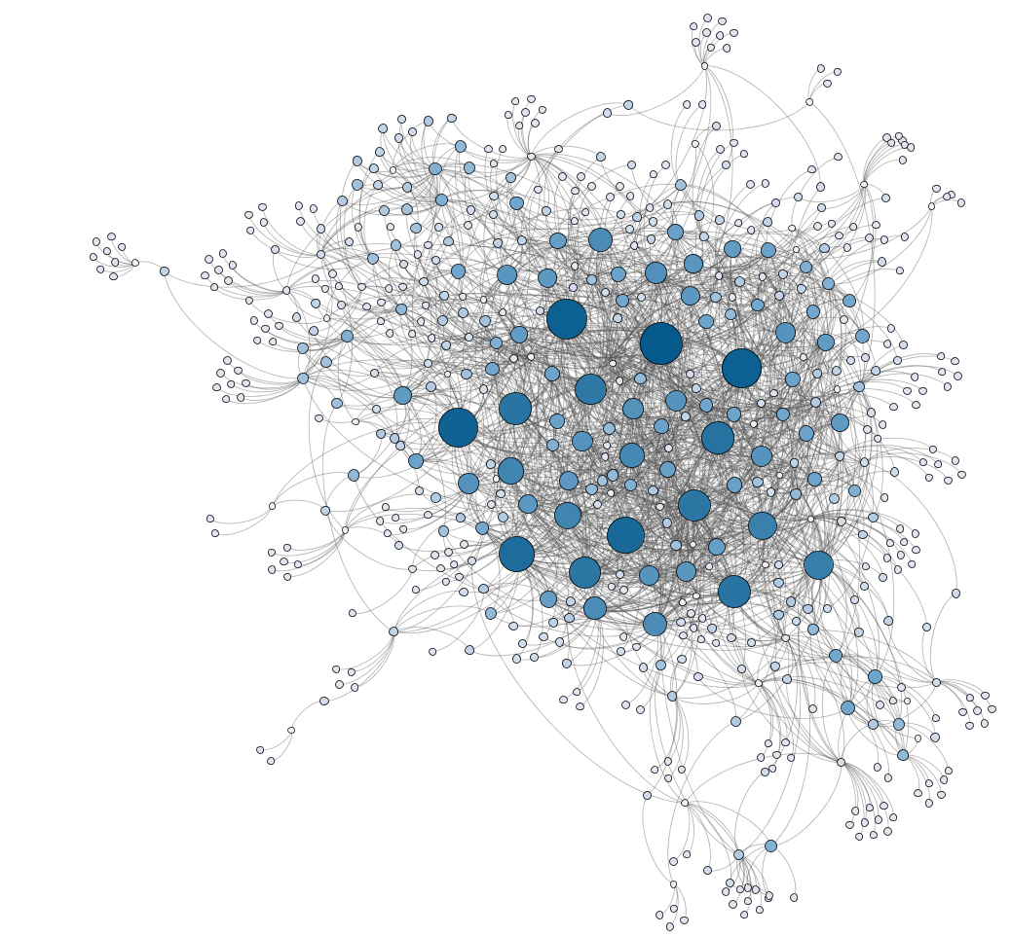
The Network of Direct Tax Cases

Slide 5
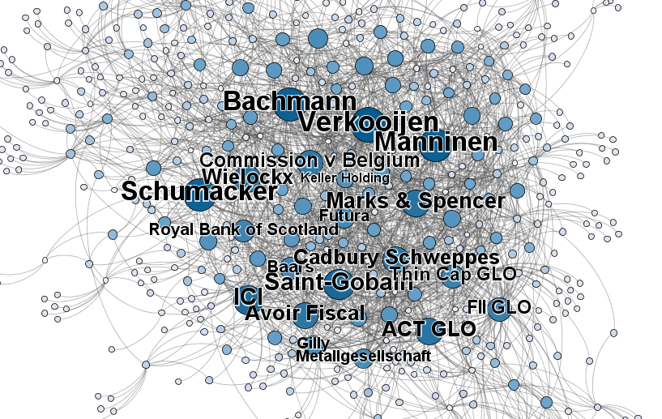
The 20 Most Important Cases

Slide 6
Colours are Communities
Community 1

Slide 7
Thesis Summary in Four Propositions
A functional subsystem of EU law with a cohesive structure and a legally meaningful self-organisation has emerged from the case law of the Court of Justice of the European Union in the field of direct taxes.

Slide 8
Thesis Summary in Four Propositions
2. Absent Union action, the Treaty on the Functioning of the EU cannot deny Member States the competence to impose taxes on economic activities carried out in national territory, if that competence is exercised in a consistent and systematic manner.

Slide 9
Thesis Summary in Four Propositions
3. The need to safeguard the balanced allocation of the power to impose tax between the Member States cannot be distinguished, on a higher level of abstraction, from the need to prevent tax avoidance and tax evasion.

Slide 10
Thesis Summary in Four Propositions
4. The need to safeguard the cohesion of the tax system is not an overriding reason of public interest, but a methodological tool to assess the suitability of tax restrictions to achieve a genuine overriding reason of public interest in a consistent and systematic manner.

Slide 11


Contact
Dr Marcel Schaper
mgh.schaper@maastrichtuniversity.nl
www.linkedin.com/in/marcelschaper
Maastricht Centre for Taxation
www.maastrichtuniversity.nl/taxation
@MaasCenterTax
The Structure and Organization of EU Law in the Field of Direct Taxes
IBFD Doctoral Series Vol. 27 | September 2013 expected
www.ibfd.org/IBFD-Products/Structure-and-Organization-EU-Law-Field-Direct-Taxes

